Slide 1
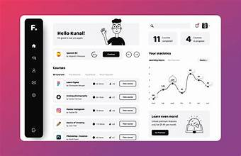
EY Techathon 5.0 Executive Summary
Date of submission: 20th Nov, 2024.
Career Catalyst (Empowering youth for career success) – By NewGen Coders

Slide 2


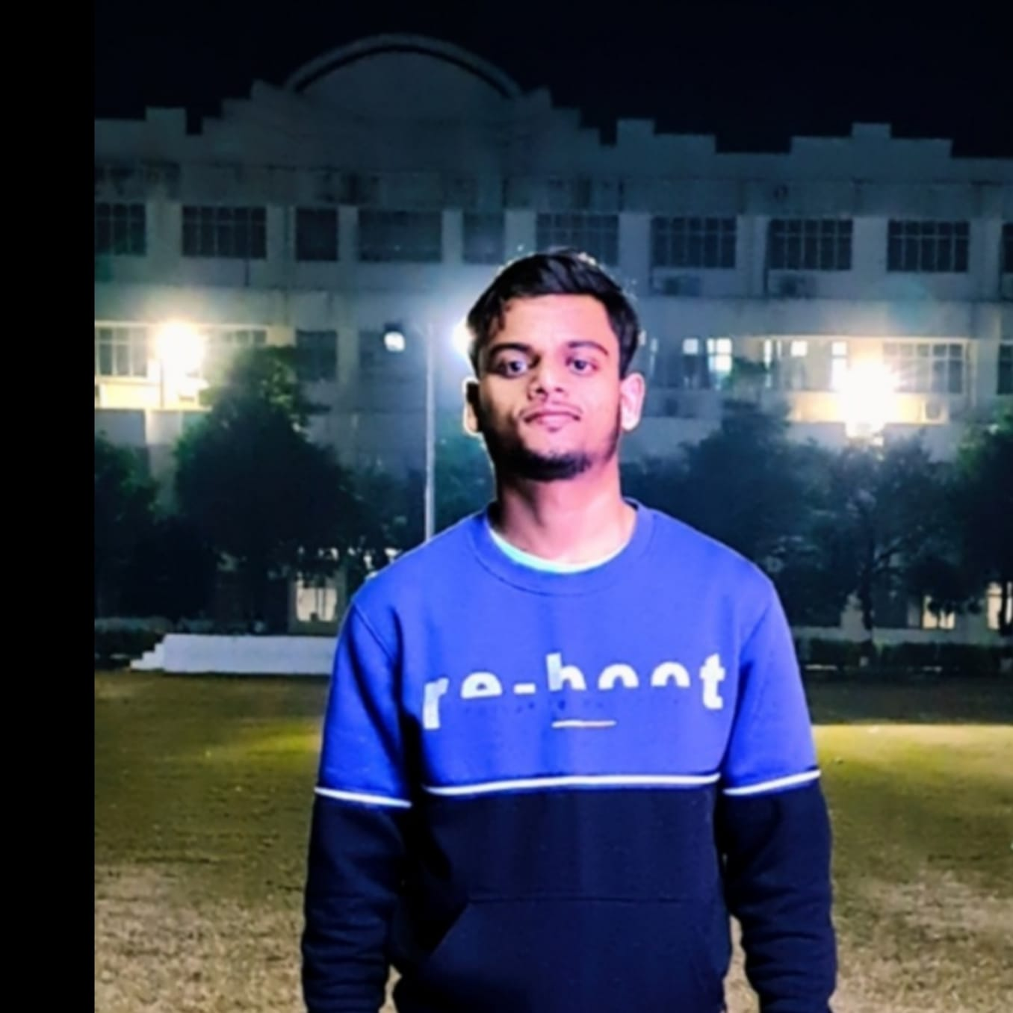
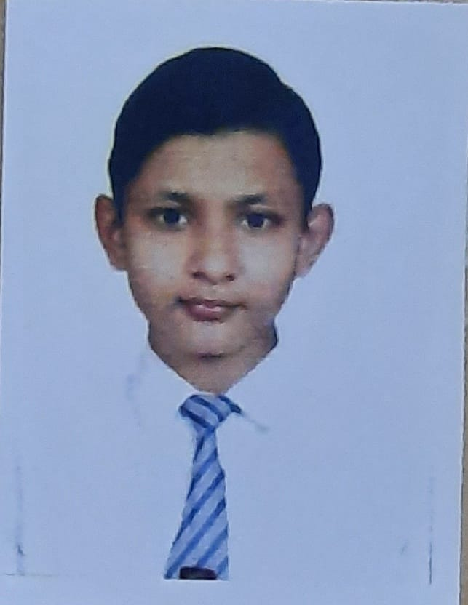
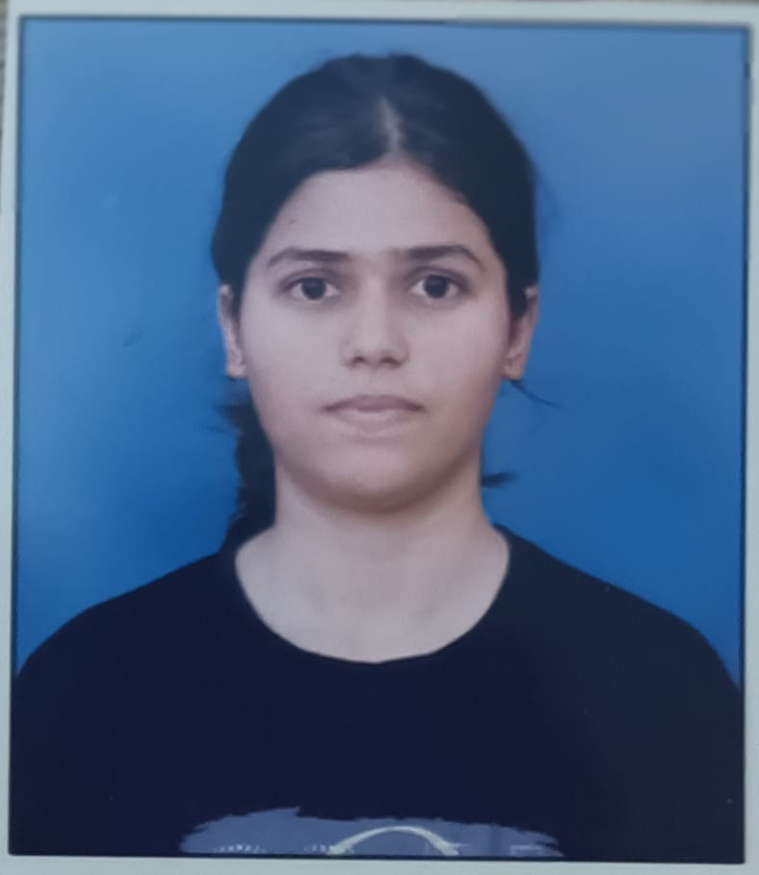
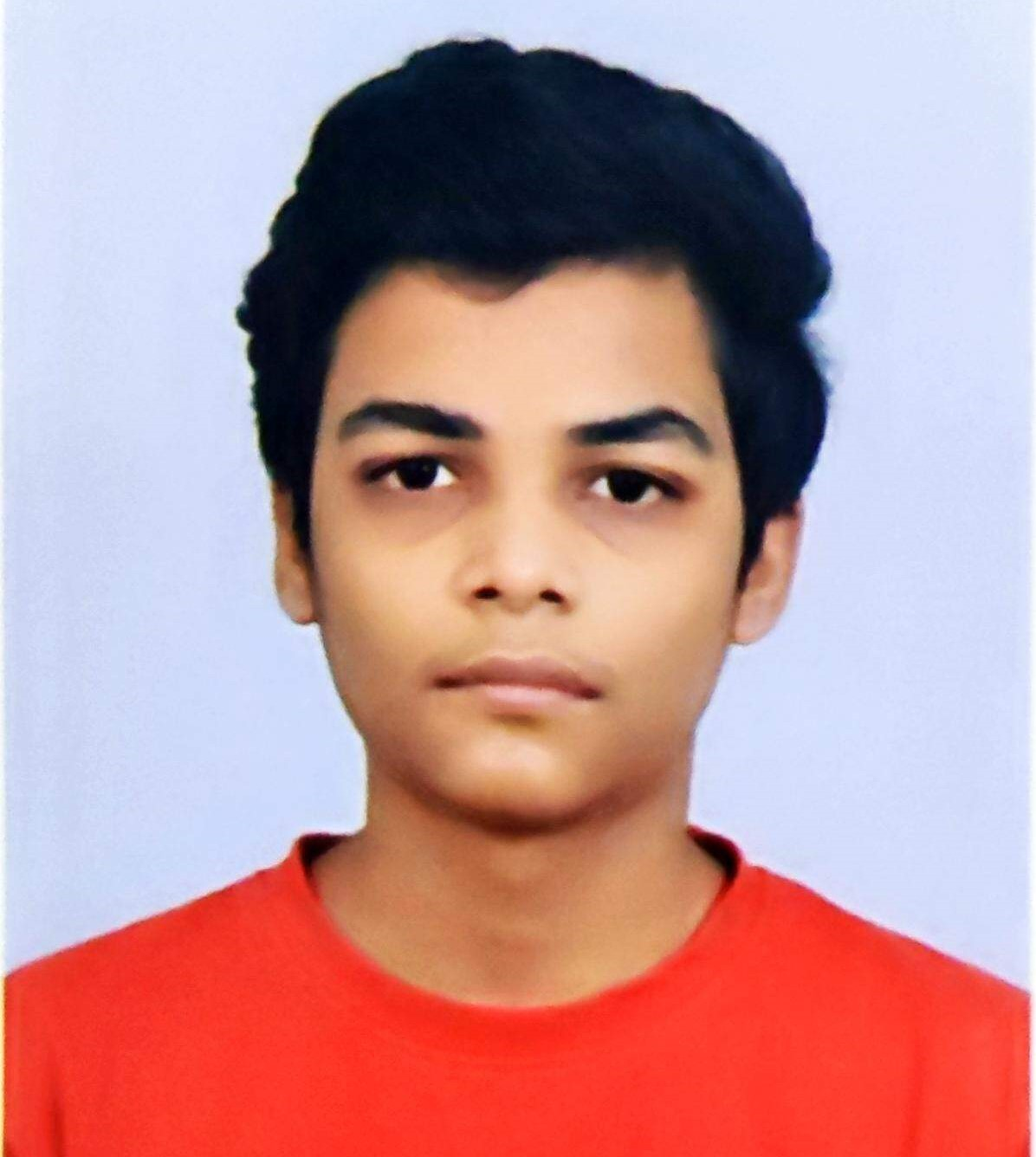
Previous Hackathon Experience: 1. Smart India Hackathon(SIH-2023, SIH-2024 ) 2. Accenture Innovation Challenge 2024 3. IBM ICE DAY 2023 GLA UNIVERSITY MATHURA – 3rd position in Technical Paper Presentation 4. Amazon ML Challenge 2024
College : GLA UNIVERSITY MATHURA
Contact : +91-9997859116
or
hardikarora483@gmail.com
Meet Our Team: NewGen Coders
Name: Nikita Chaudhary
Designation: (Frontend Developer)
My Contribution in team:
I design sleek, user-friendly interfaces for an engaging experience.
Name: Kushagra Maheshwari
Designation: (Backend Developer)
My Contribution in team:
I build robust and scalable infrastructure for the platform.
Name: Hardik Arora
Designation: (Team Lead)
My Contribution in team:
I drive strategies and ensure seamless execution with expertise in AI/ML solutions.
Name: Harsh Raj
Designation: (Research & QA Specialist)
My Contribution in team:
I align solutions with market trends and ensure top-notch performance.
Name: Shiven Rastogi
Designation: (Data Scientist)
My Contribution in team:
I craft intelligent Machine Learning models for personalized recommendations.

Slide 3
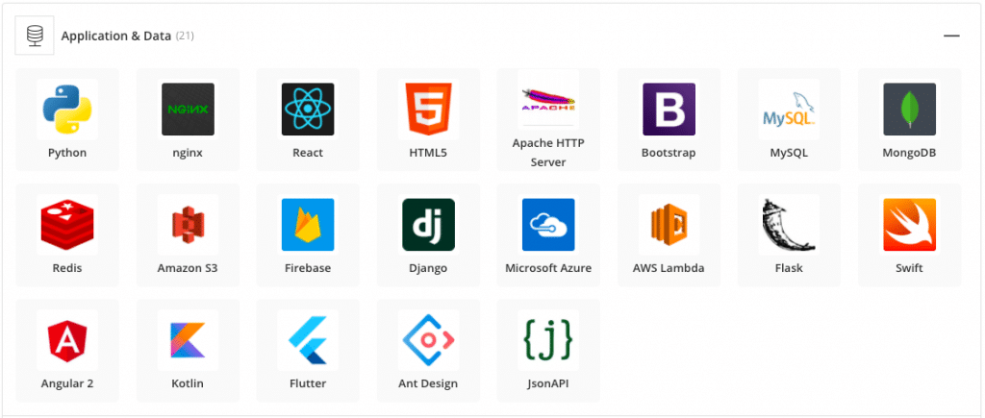
This AI-powered web application provides an innovative and scalable solution for the skill development challenges faced by youth. By leveraging cutting-edge technology and focusing on user-centric design, the platform ensures a sustainable impact, equipping students like Vivek to thrive in an ever-changing job market.
Problem statement: Education - AI for Skill Development in Youth
Solution Form Factor: Web App
Brief overview :
Overview:
Our solution is an AI-powered web application designed to help students like Vivek identify and build the skills required to achieve their career goals. The platform leverages AI to assess current skills, recommend personalized learning paths, and track progress, enabling students to bridge the gap between their potential and the ever-changing demands of the job market.
Core Features:
Skill Assessment
Personalized Career Guidance
Customized Learning Plans
Progress Tracking and Feedback
Accessibility and Inclusivity
Key Technologies Used:
AI and Machine Learning
Natural Language Processing (NLP)
ReactJS, Node.js, MongoDB
Cloud Infrastructure
API Integrations
How It Solves the Problem:
Closes the Career Guidance Gap: Students like Vivek often lack structured guidance. The app acts as a digital mentor, empowering them with clarity on skill development.
Bridges the Skill Gap: By mapping current skills to career goals, the platform ensures students focus on acquiring relevant skills tailored to industry demands.
Empowers the Underserved: The platform’s low-tech accessibility ensures equitable access for students from rural or resource-constrained regions.
Techstack we will be using:

